Slide 1

DeepSafe – Verification Layer for Synthetic Media
Team Name: Digital Piece
Domain: AI + Cybersecurity + Digital Forensics
Problem: AI-generated deepfakes threaten digital trust, journalism, elections, and cybersecurity.

Slide 2
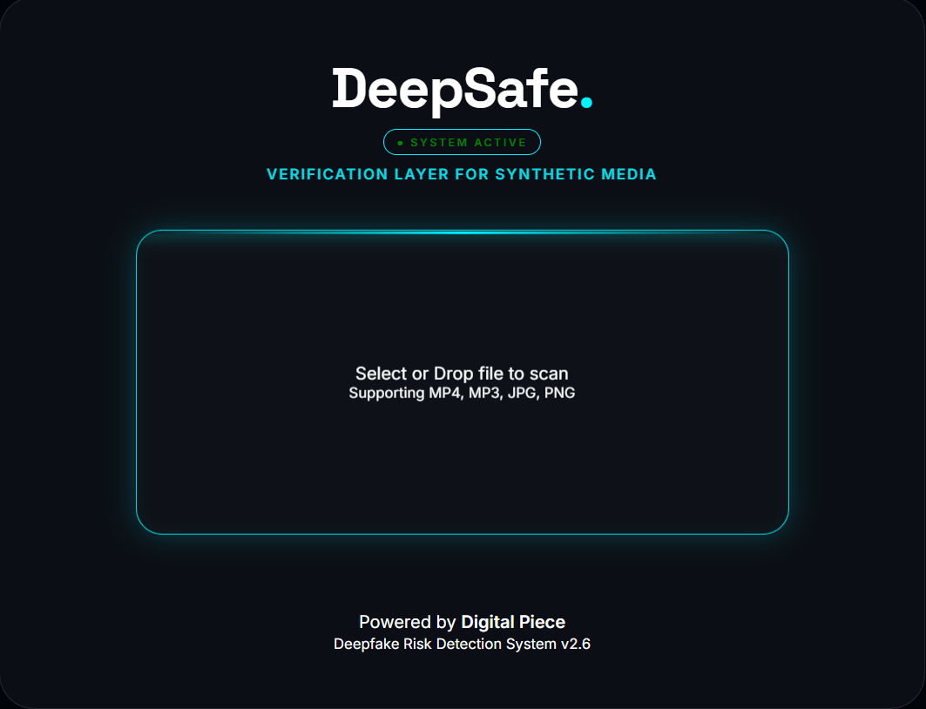
ABOUT WEBSITE
DeepSafe is a forensic AI web application that:
Accepts Image, Audio, Video files
Uses AI models to detect manipulation
Returns AI probability score
Displays forensic analysis logs
Shows authenticity verdict

Slide 3
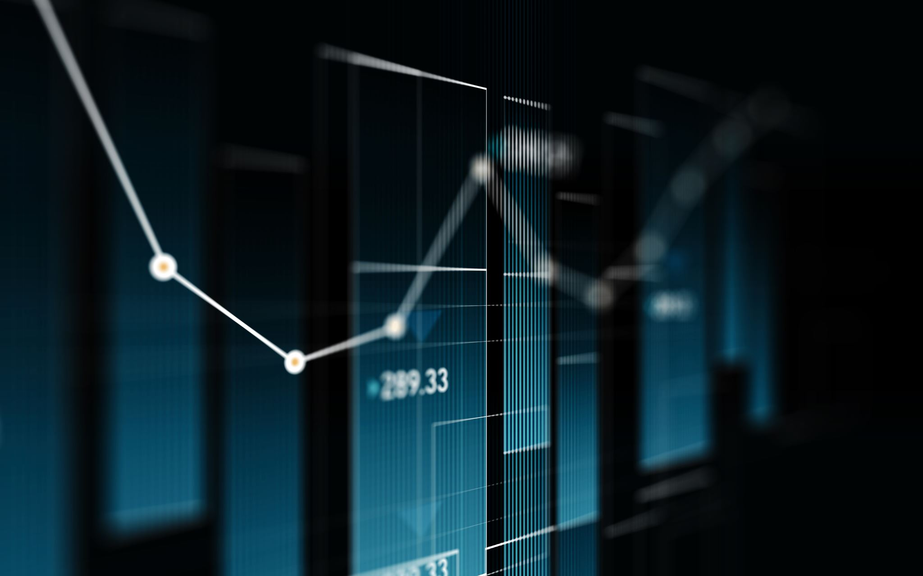
ALGORITHM – HOW IT WORKS
Images: API analysis → Probability score → ≥50% Fake, <50% Authentic
Audio: Detects cloning artifacts & spectral inconsistencies
Video: Extract frames → Score each frame → Average result

Slide 4




SYSTEM ARCHITECTURE
Frontend: HTML, CSS, JavaScript
Backend: Node.js, Express, Multer, FFmpeg
AI Engine: Reality Defender API
Secure API key in .env

Slide 5
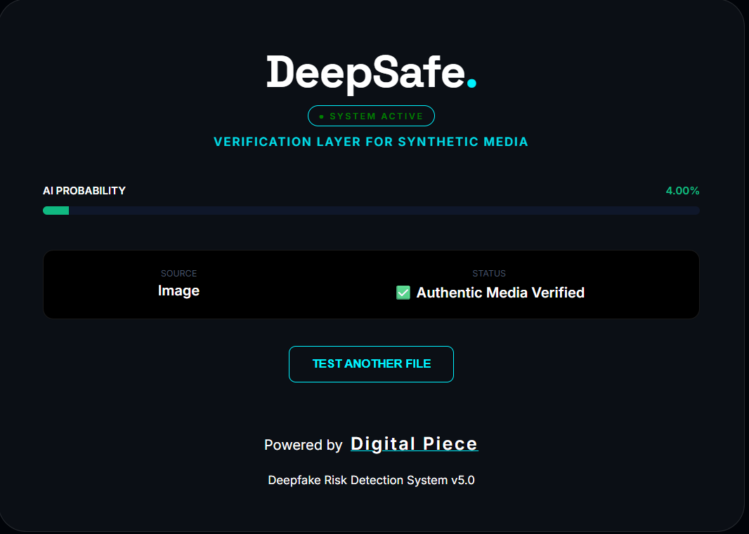
INTERFACE & BUTTONS
Animated intro portalSystem Active indicatorDrag & drop upload
Risk probability meter
Green = Authentic | Red = Fake
Live forensic logs

Slide 6
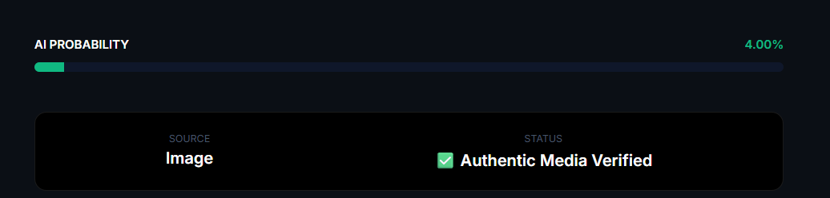
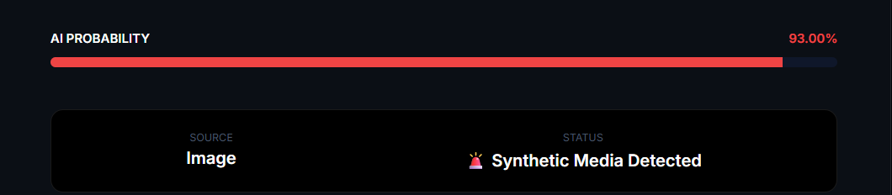
REAL vs FAKE SCREENSHOTS
Real Image → 3% → Authentic
Fake Image → 93% → Synthetic
Real Video → Low %
Deepfake Video → High %

Slide 7
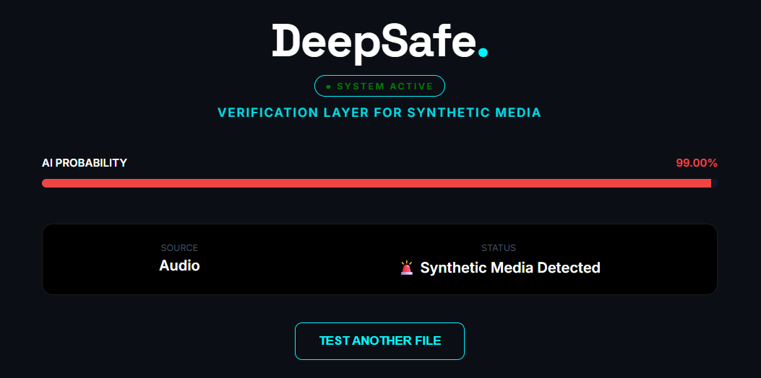
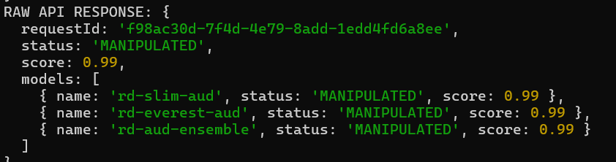
AUDIO FILE SCREENSHOT
Upload audio
Detection result
AI probability

Slide 8
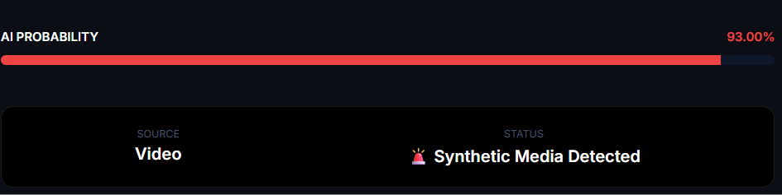
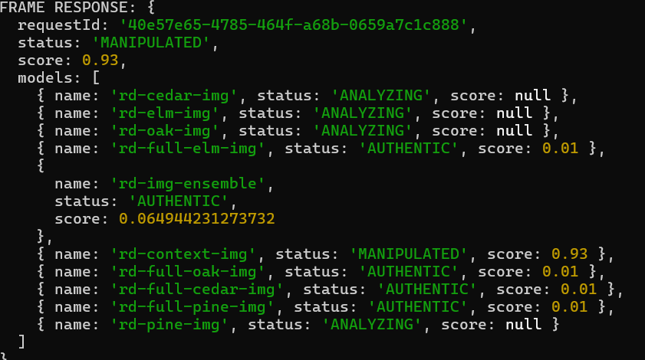
VIDEO SCREENSHOT
Frame extraction logs
Frame score updates
Final average result

Slide 9
TECH STACK
Frontend: HTML5, CSS3, JavaScript
Backend: Node.js, Express, Multer, FFmpeg
AI Engine: Reality Defender API
Tools: VS Code, Postman, Chrome DevTools

Slide 10
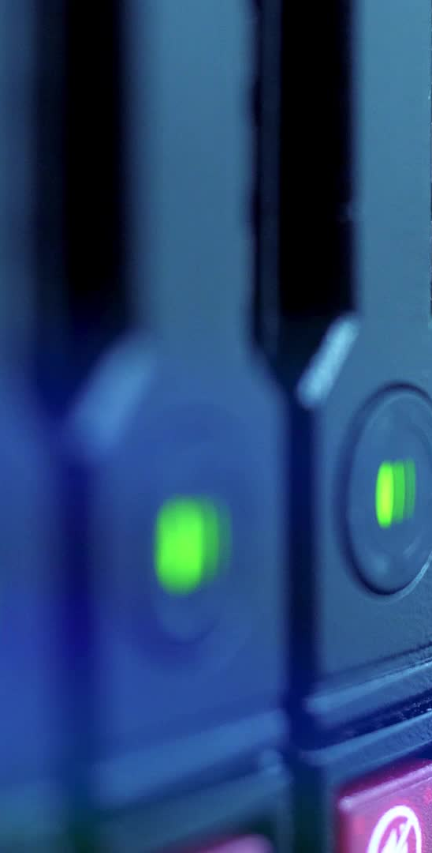
SECURITY FEATURES
API key hidden in backend
File auto deletion after processing
No permanent data storage
Secure server-side processing
Safe CORS configuration

Slide 11
INNOVATION
Real forensic AI models
Multi-frame video analysis
Live progress logs
Cyber-forensic UI
Real-time probability calculation

Slide 12
FUTURE SCOPE
Blockchain verification layer
Browser extension
Social media integration
Bulk media scanning
Deepfake heatmap visualization
Model ensemble comparison

Slide 13
DEMO FLOW
Upload media
Backend sends to forensic AI
Models analyze artifacts
Generate confidence score
Aggregate result
Display probability meter & verdict

Slide 14
IMPACT
Helps journalists verify media
Assists law enforcement
Supports social media moderation
Empowers individuals

Slide 15

THANK YOU
Verification Layer for Synthetic Media
“Never Trust. Always Verify.”

